Slide 1
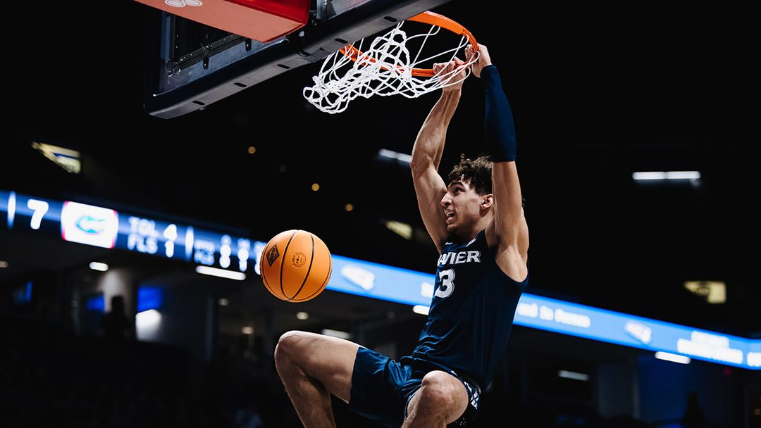
Bracket Busters
March Data Crunch Madness 2022
By: Brian Rochford, Kevin Chavez, Chris Tarzian & Vibhav Raghav

Slide 2
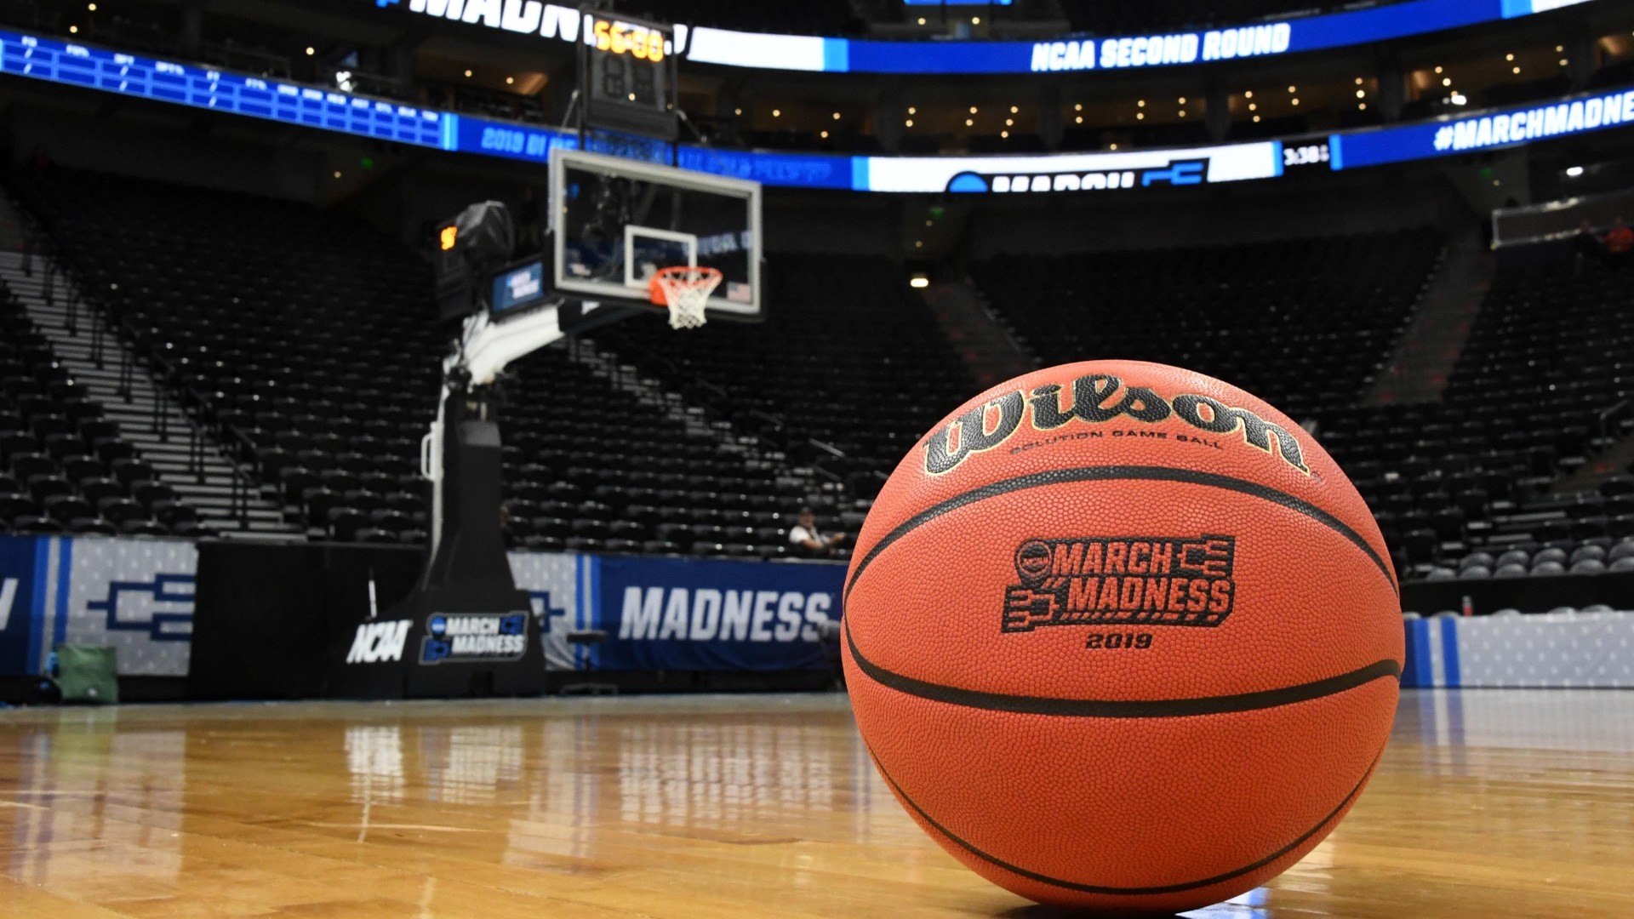
Introduction
Predicting 2022 Men’s Basketball March Madness Champion
68 Teams (including play-in teams)
67 Games (including play-in games)
The longest streak of correct predictions for a bracket is 49 accomplished in 2019
The unpredictability of the tournament is well documented
Currently NO perfect brackets remain in 2022

Slide 3
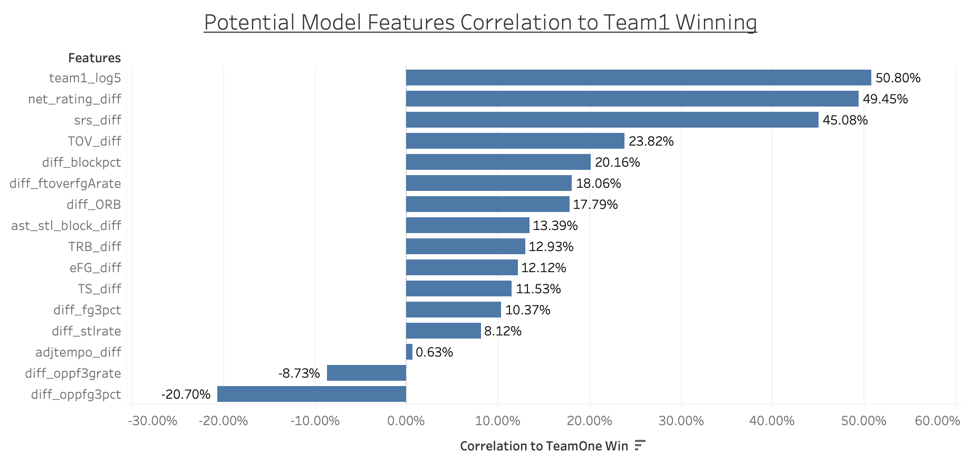
Data Processing
Outsourced much of our data from Sports Reference.com
Wanted to beef up our analysis with basketball heavy variables
Sought to eliminate variables with minimal correlation to Team1_win
Aimed to reduce multicollinearity by identifying features that would be too heavily correlated with each other
For example:
Net Ranking and Win Tempo Diff were heavily correlated. Eliminated Win Tempo Diff

Slide 4

Model Building
We focused on Logistic Regression and Random Forest Classification models
Models built in Python
Team1_win was the targeted prediction
Used a 70% training set and 30% testing set
30 Features to initially choose from
Features were narrowed down using feature selection and feature correlation

Slide 5
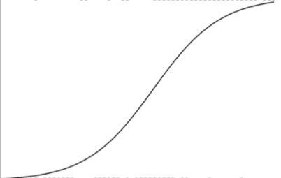
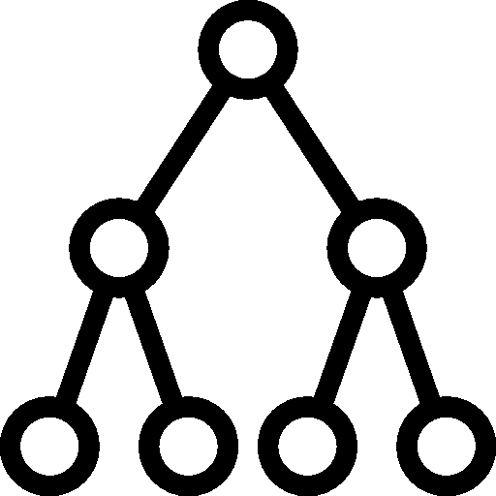
Model Selection
Logistic Regression
Random Forest
VS
On testing data:
75% accuracy
Log Loss: 0.5429
For 2019 Predictions:
Log Loss: 0.475
Correctly predicted games: 50
On testing data:
73% accuracy
Log Loss: 0.560
For 2019 Predictions:
Log Loss: 0.398
Correctly predicted games: 55
Winner: Random Forest!!

Slide 6
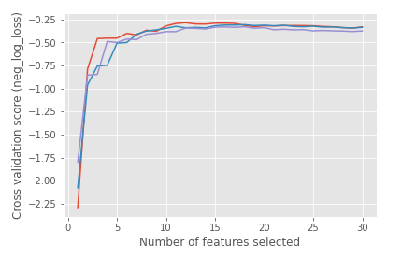
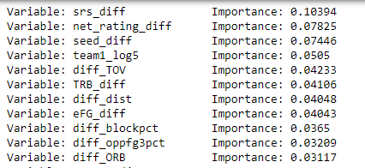
Random Forest Insights
Feature selection optimized at 10 variables
Model was overfitting when run with 5 variables
Number of estimators, random state, max number of features, were attributes we modified in our model
Feature Importance favored two variables we made:
srs_diff
net_rating_diff

Slide 7







SRS Rating
Past Champions
#1 in SRS rating
2016 Champion
#2 in SRS rating
2017 Champion
#1 in SRS rating
2018 Champion
#3 in SRS rating
2019 Champion
#2 in SRS rating
2021 Champion
SRS (Simple Rating System)
Rating that takes into account average point differential and strength of schedule
Great predictor of past champions
2022 Teams Top 3 in SRS:
Gonzaga
Arizona
Houston

Slide 8
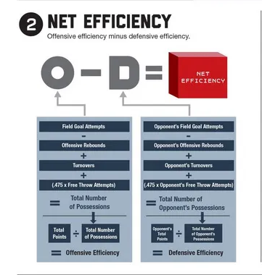
Net Ranking
Adjusted Offensive efficiency minus Adjusted Defensive efficiency
Took the difference in Team 1 Net Ranking and Team 2 Net Ranking
2nd most important feature
Used in our final model

Slide 9
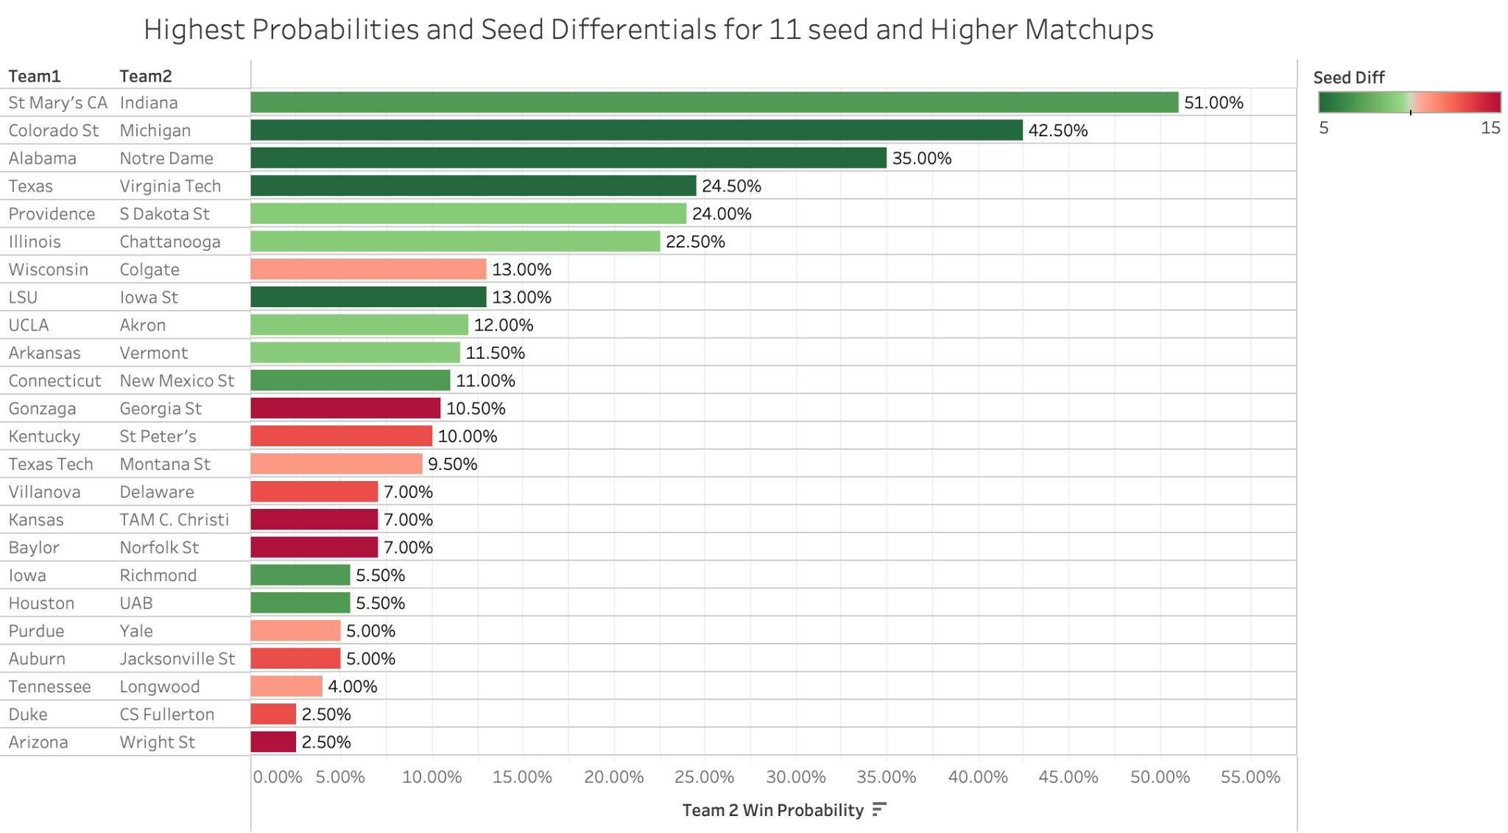
Potential Upsets for First Round
Three 11 seeds had favorable matchups for a potential upset in the first round
Michigan
Notre Dame
Indiana
Michigan and Notre Dame pulled off the upset

Slide 10

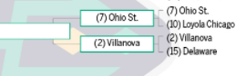
Friendly Competition
VS
Two members of our team attended Villanova & Ohio State respectively
Teams faced off in the round of 32
Villanova pulled out a victory in a tightly contested game
Go Cats!
Villanova had a 68.5% probability to win
(2) Villanova

Slide 11
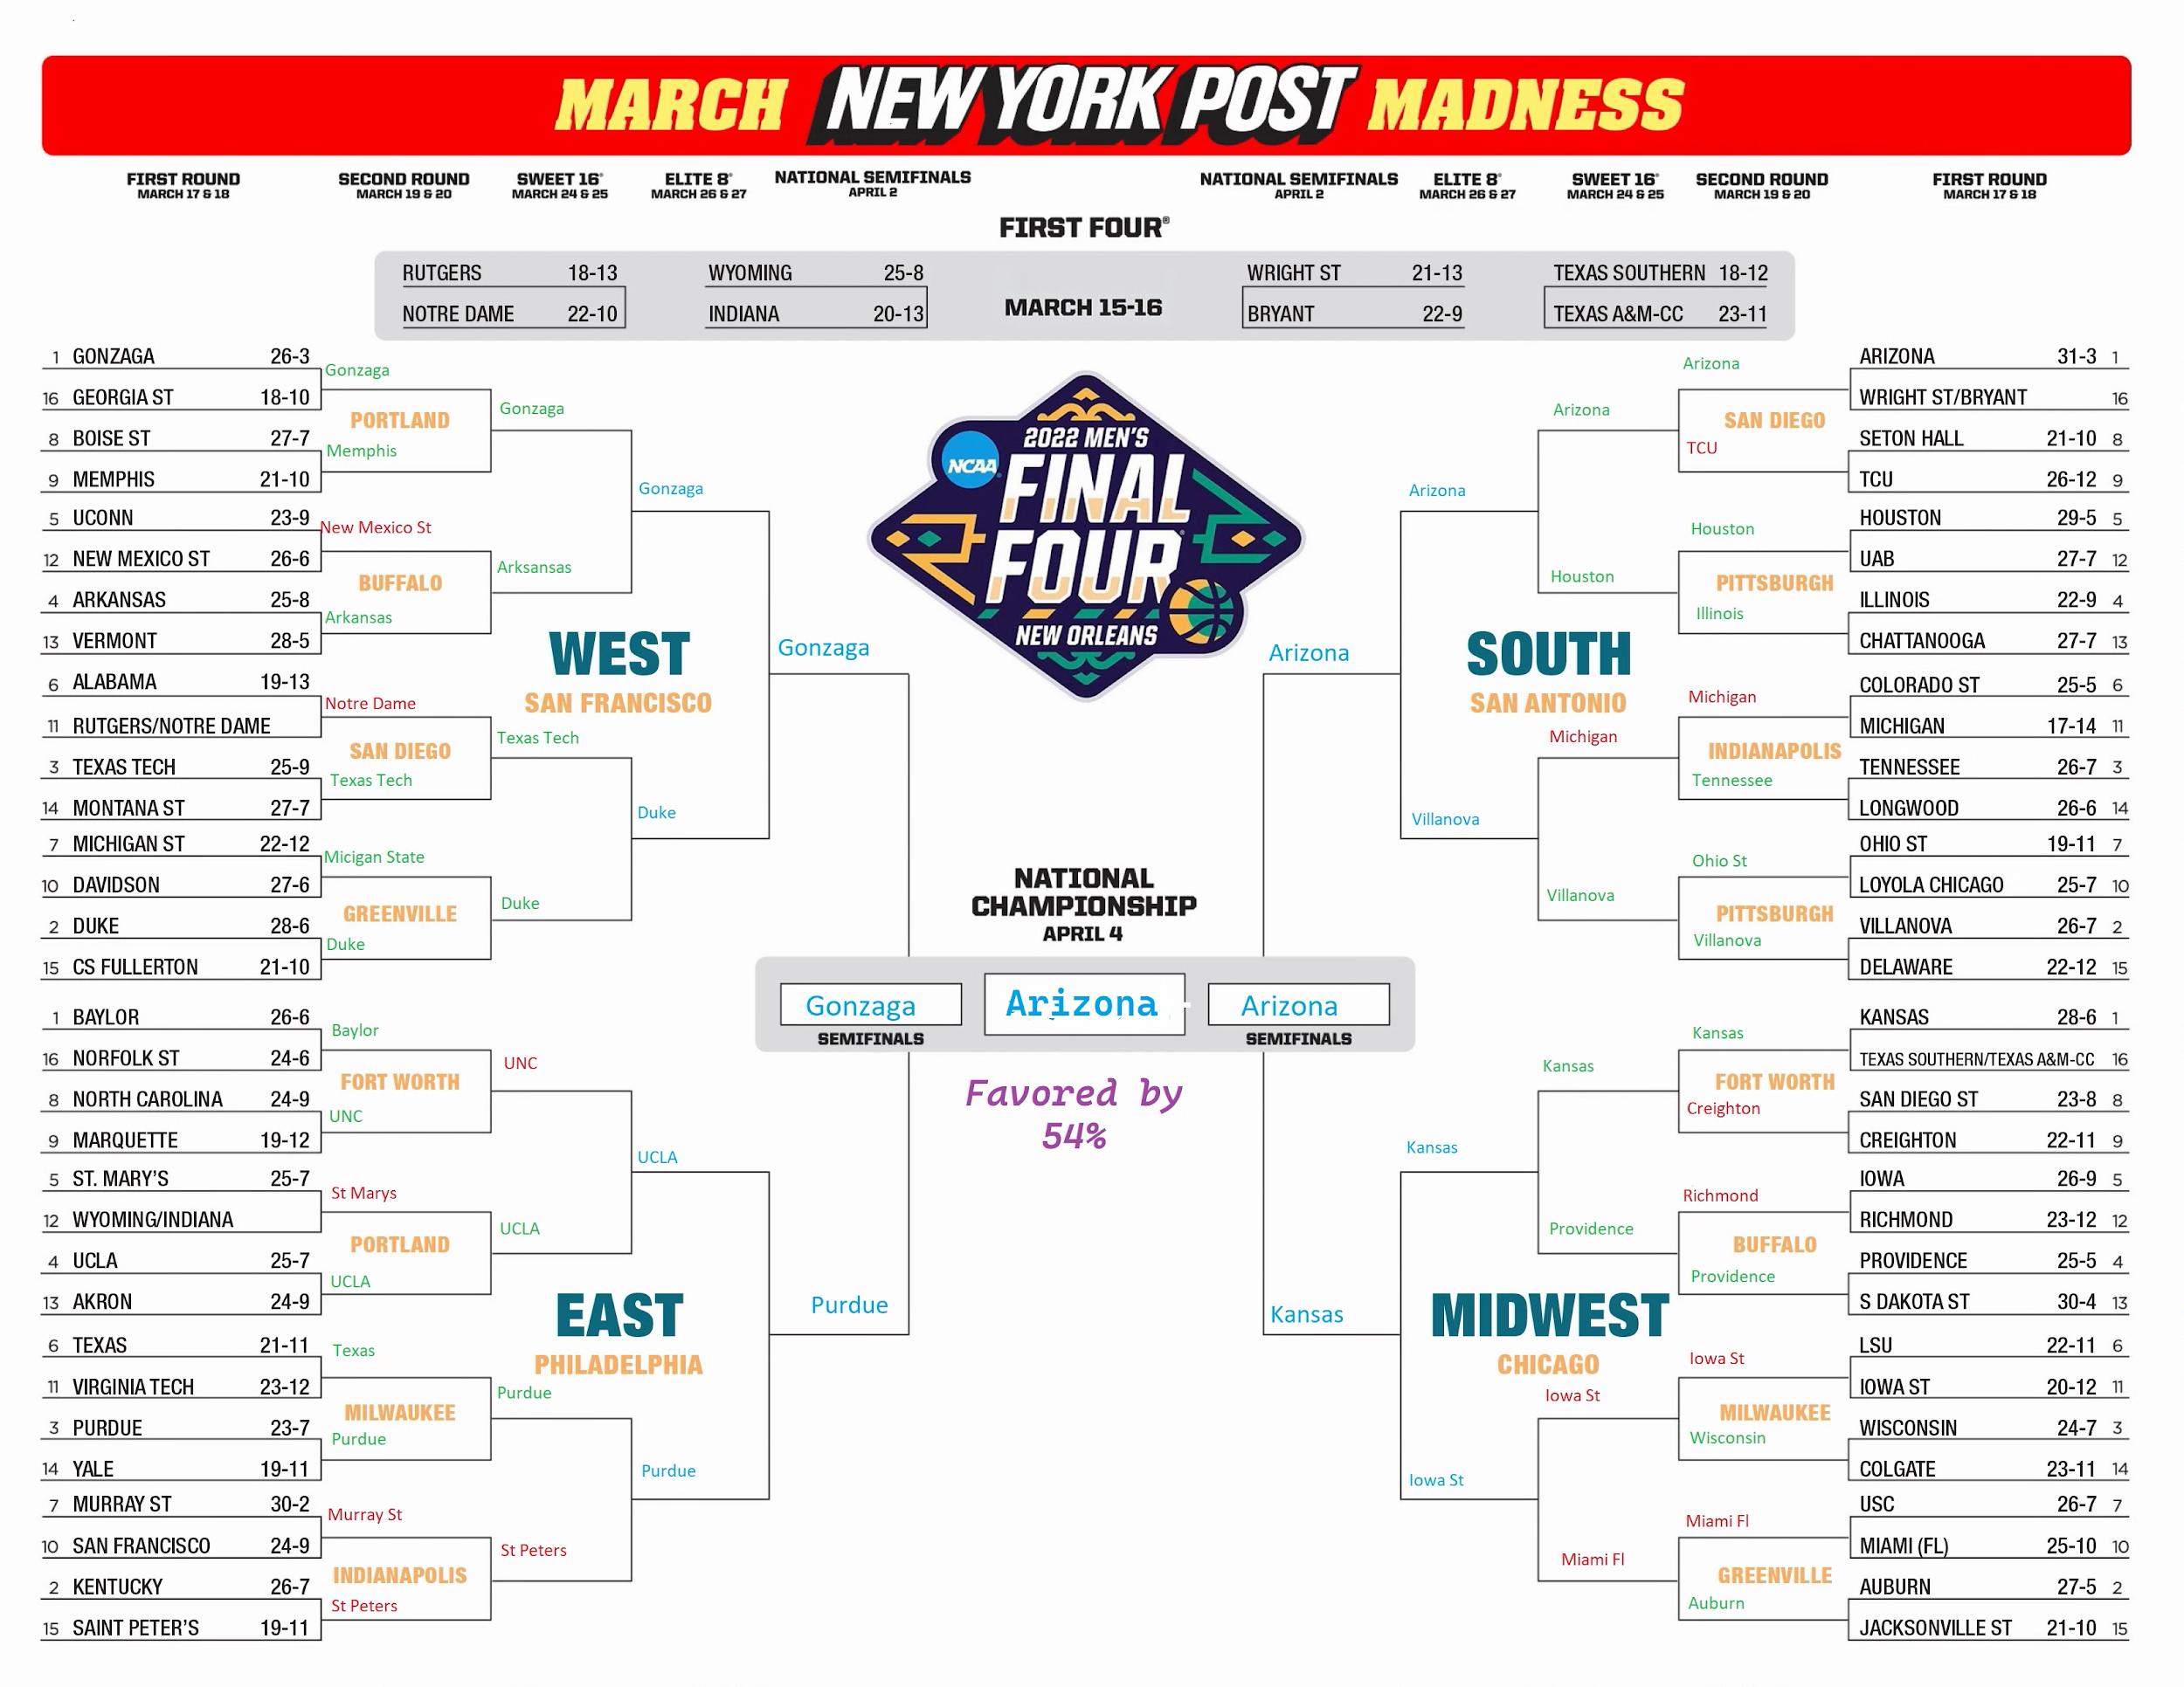
Updated Bracket and Current Predictions
Arizona Wildcats
2022 MM Champions

Slide 12
Changes for Future Tournament Models
Implement a reducer that mitigates extremely high probabilities for winning teams. Thus, Log Loss won’t be so heavily affected by major upsets
Create an Upset Feature that could swing probabilities to the lower seeded team if they were within striking distance of the favorite
Use an Ensemble model and combine the results of multiple models for more efficient/accurate results

Slide 13
References
https://www.sports-reference.com/cbb/seasons/2021-advanced-school-stats.html
https://kenpom.com/
https://www.kaggle.com/c/ncaam-march-mania-2021
https://scikit-learn.org/stable/modules/generated/sklearn.ensemble.RandomForestClassifier.html#sklearn.ensemble.RandomForestClassifier.predict_log_proba
https://towardsdatascience.com/random-forest-in-python-24d0893d51c0

